Slide 1
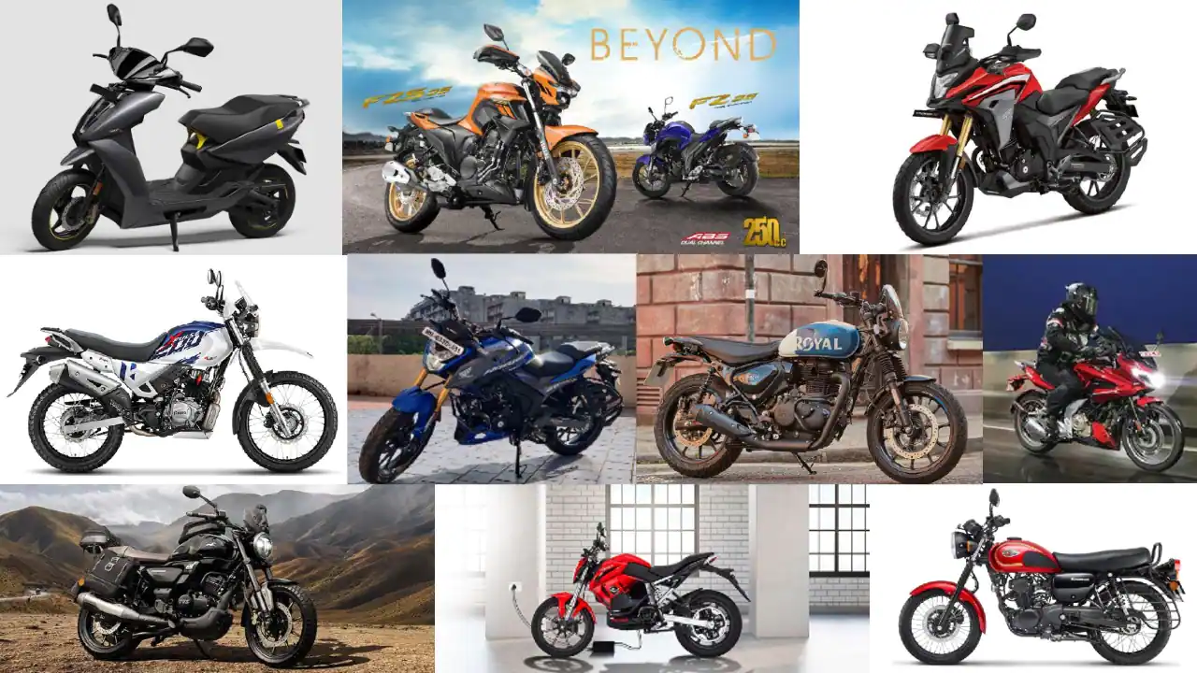
NUMBER OF BIKE USERS IN THE CITY PREDICTION
Team 9:
Team Members:
B.Dharani
N.Shailaja
Madhuraju suresh
Borado laxmikanth
B.Harshavardhan Reddy

Slide 2

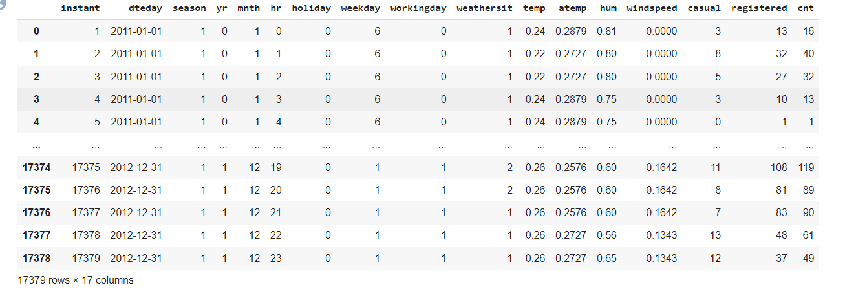
Dataset :
Here, the Bikes sharing data consists of various information related to bike users in different weather conditions which includes season, temp, windspeed etc.it has 17 columns and 17379

Slide 3
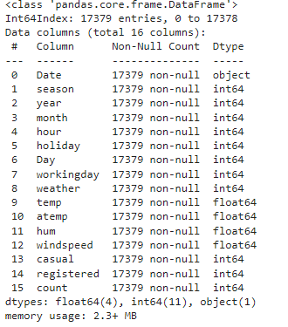
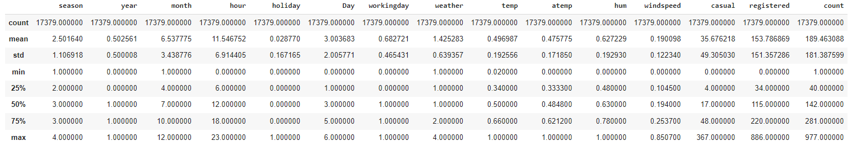
Data Pre-processing :
For machine learning algorithm it is necessary to convert raw data into clean data set which means converting the data set into numeric data
Here we defined new columns which are(data,season,month,hour,holiday, hour,windspeed,etc)

Slide 4
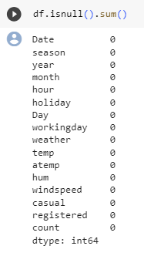
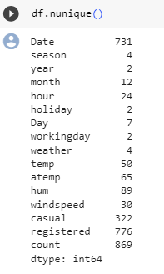
DATA CLEANING:
In this process we are going to find out the null values (missing data)
Then we find the unique vales which helps in data analysis and pre- processing

Slide 5
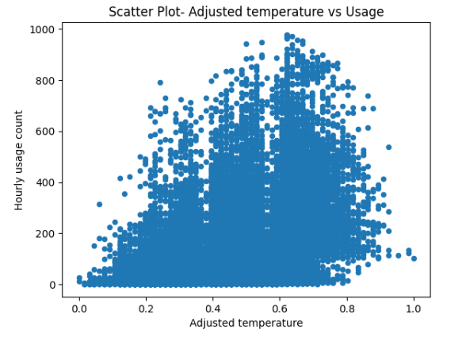
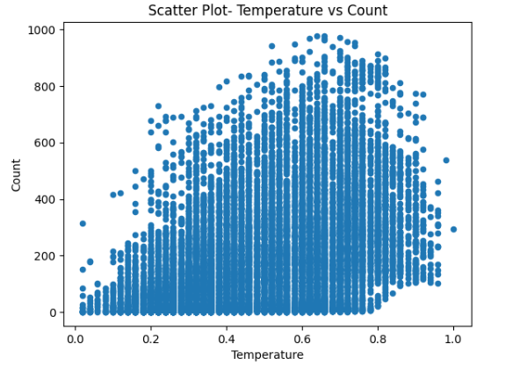
Exploratory Data Analysis(EDA): Scatter plots:
The below scatter plot shows the information Scatter Plot- Adjusted temperature vs Usage
The below scatter plot shows the information Scatter Plot- Temperature vs Count

Slide 6
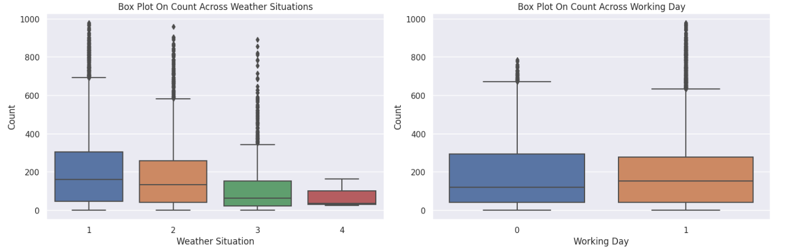
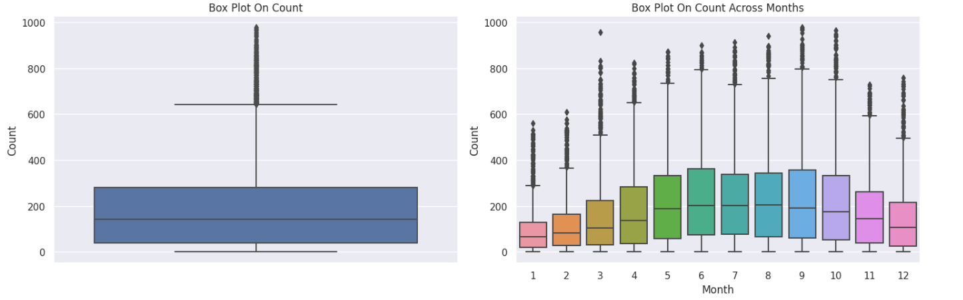
Bar plots:

Slide 7

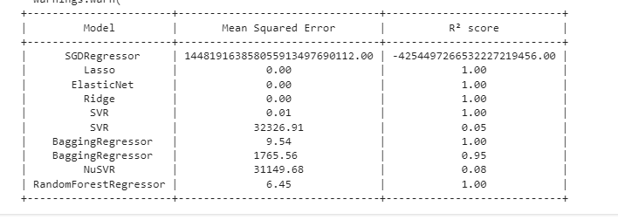
Regression:
Evaluate the Model
Common metrics for regression include Mean Squared Error (MSE), Root Mean Squared Error (RMSE), and R-squared (R²). These metrics measure the goodness of fit and predictive accuracy.
List Of Regression Models
Ridge Regression, Support Vector Regression, Ensemble Regressor, Random Forest Regressor

Slide 8
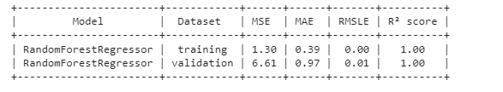
Random Forest Model :

Slide 9
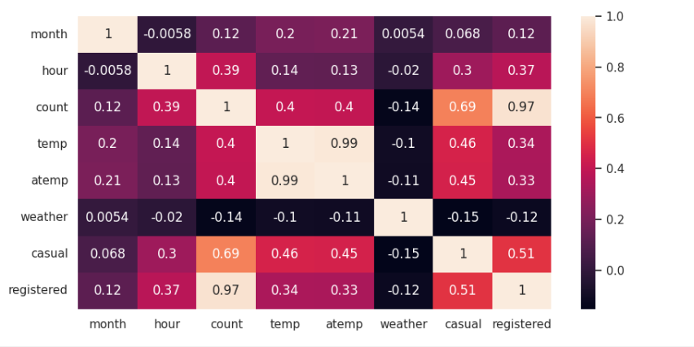
Heat Map:

Slide 10
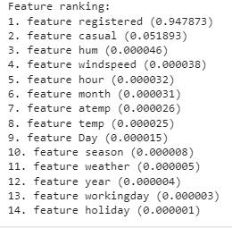
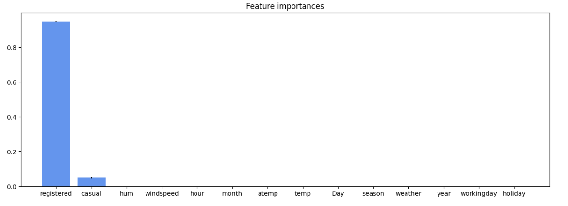
Feature Importance:

Slide 11
OBSERVATIONS:
The Value Of Mean Squared Error For Linear regression prediction vs actual is :
144819163858055913497690112.00
The value of Mean squared Error for Lasso regression predicted vs actual is :
14481916385805591349769158.23589
The result corresponds to the high correlation of the registered and casual usage variable with the bike sharing count in the feature correlation matrix.

Slide 12
INFERNCES & CONCLUSION :
We can conclude that the temperature and other things like weather have the impact in the people riding the bikes
The given features in the dataset have the most influence on the number of bike users.
From the given raw data and the processed data we can understand that the bikers have different interests in riding the bikes

Slide 13


https://colab.research.google.com/drive/1xjd_mxaaPADKwR8rAk4yDe2JDTV1Qix2?usp=sharing

